Slide 1
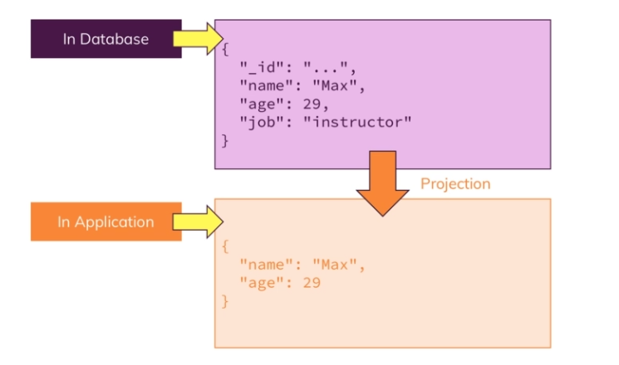
Projection
Filter data in Mongo DB before sending it to the application.
Remember this transformation is happen before the data shipped to the application

Slide 2
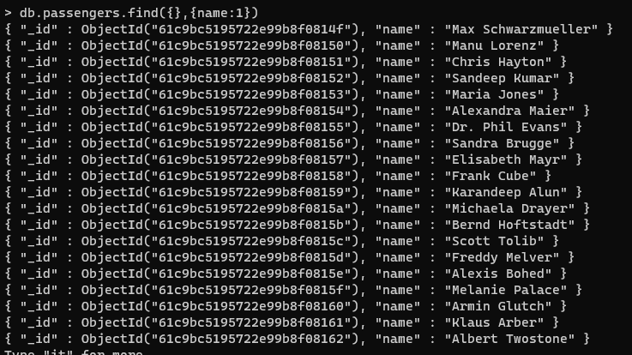
Projection example
As u can see we return just the name, the age is not returned.
Reminder: find arguments: first → filter, second → what we want to return with the value 1 that meaning yes

Slide 3
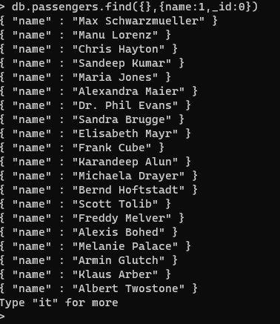
Projection 2 Example
We get only objects with the names

Slide 4
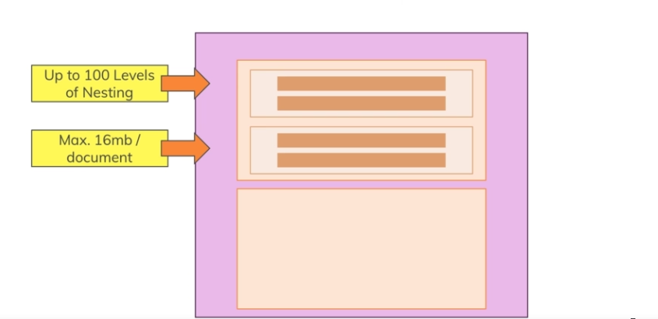
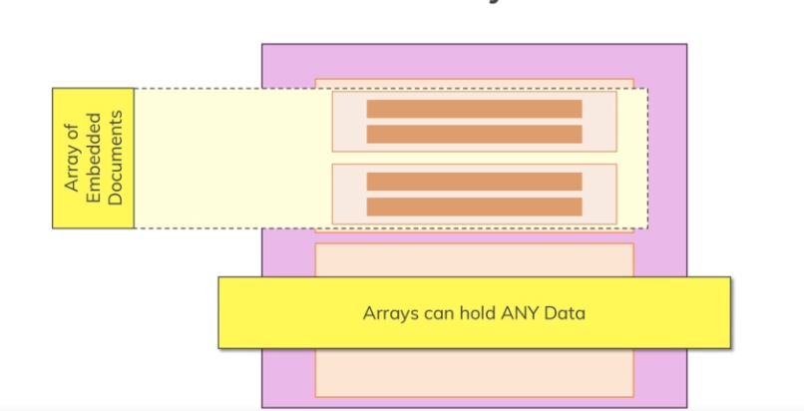
Embedded documents
Its core feature in Mongo DB.
U can have a field in your document, that the value of this field can be another document.
U can nest your documents.
There is hard-limit up to 100 levels of nesting in Mongo DB
Hard limit of documents size below 16MB
U can store arrays, for example arrays of embedded documents.

Slide 5
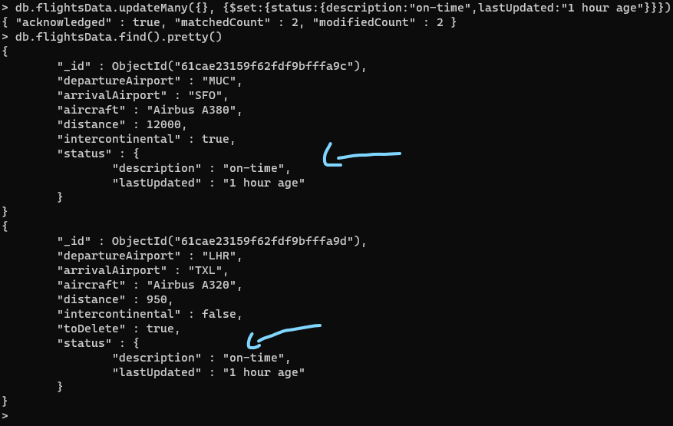
Working With Embedded documents
There is nested documents.
We have two documents in flightData collection and in each document there
is another document (sub document)

Slide 6
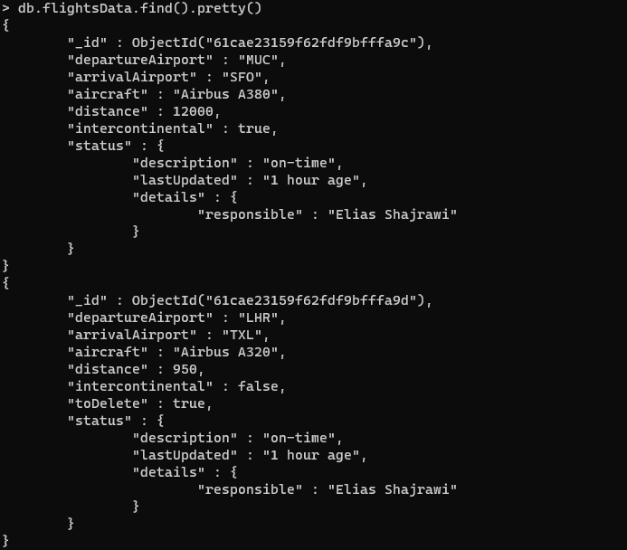
Embedded documents
Document under another document under another document

Slide 7
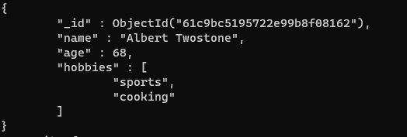
Nested documents working with Arrays
List of string
In this example we add strings, but we can add another nested documents.

Slide 8

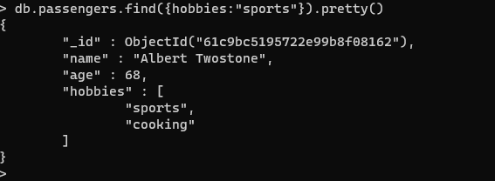
Accessing Structured Data
We can access this filed. Use findOne
Check all the passengers with sports hobbies included

Slide 9
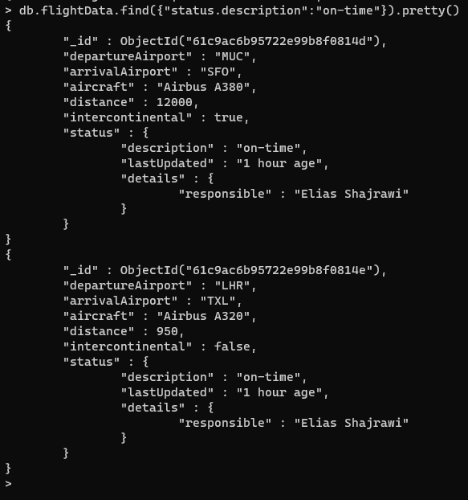
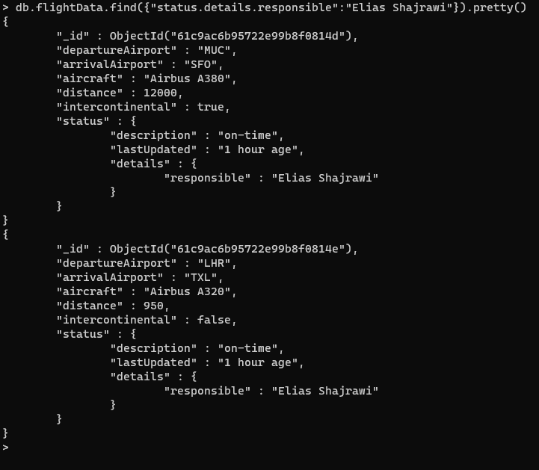
Accessing structured data

Slide 10
Resetting Your Database
To get rid of your data, you can simply load the database you want to get rid of (use databaseName) and then execute db.dropDatabase().
Similarly, you could get rid of a single collection in a database via db.myCollection.drop().

Slide 11
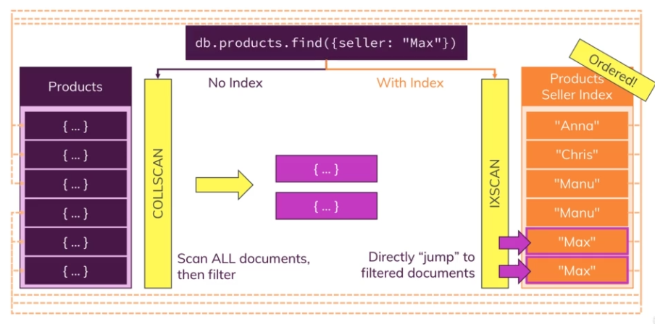
Indexes & Why
And index can speed up our find, update, or delete queries.
Index is not replacement for a collection but an addition.
So, it’s order list for the searching values, the field for which you created.
Every item in the index has a pointer to the full document

Slide 12
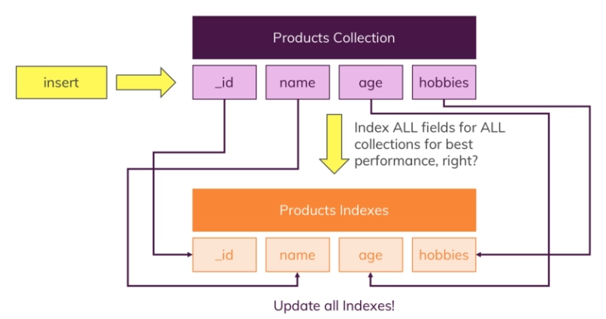
Don’t Use Too Many Indexes!
Its going to speed up your find queries, because we can query every field efficiently. BUT and index don’t not come for free, you will pay some performance cost on inserts operations because that extra index that has to be maintained needs.

Slide 13
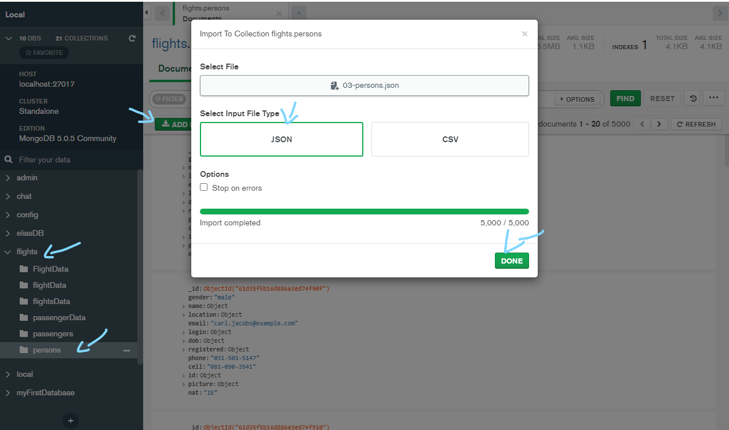
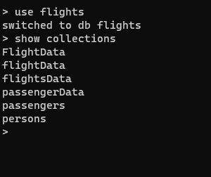
Import new collection to Flight DB

Slide 14
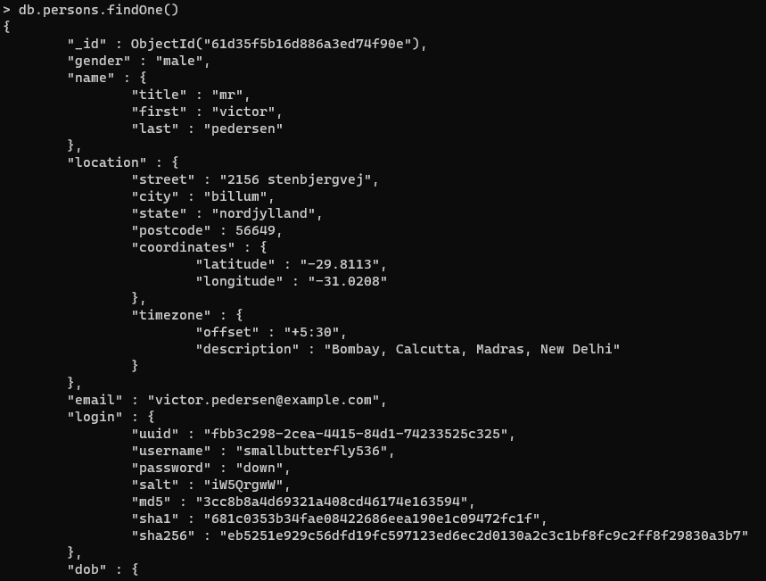
Let Take A look on the persons collection

Slide 15
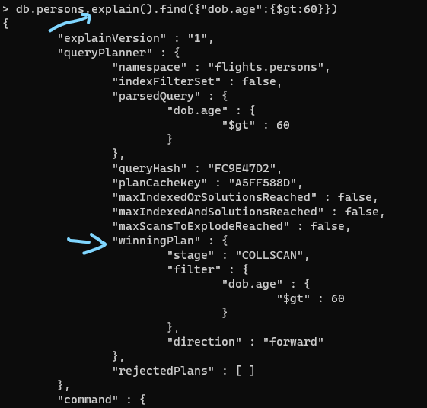
Do we Need Index !!! Check Performance
Run Query and let’s find all people who are older than 60
In order to determine whether an index
can help us or to see what mongodB does,
we should analyze how it executed the query
explain() → work on find() update() delete()
As u can see there is winningPlan → stage: collection scan will
Scan all the document to find what we want.
Then as u can see we need index its not good if there is 1 million docs
MongoDB thinks in so-called plans.
Plans considers for executing query.

Slide 16
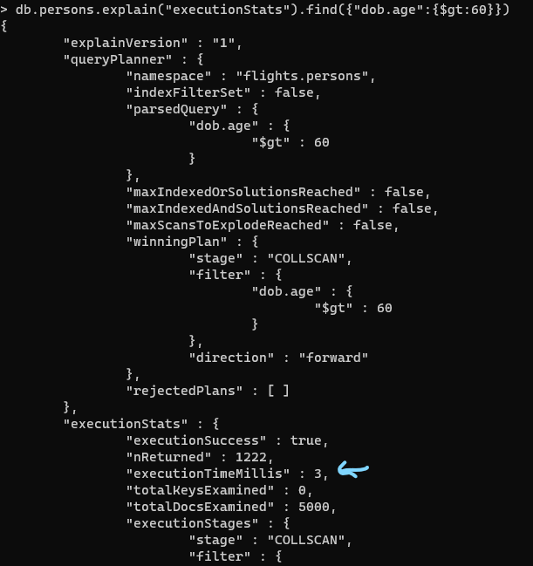
Do we Need Index !!! Check Performance
Take 3 milliseconds
Scan documents 5000

Slide 17
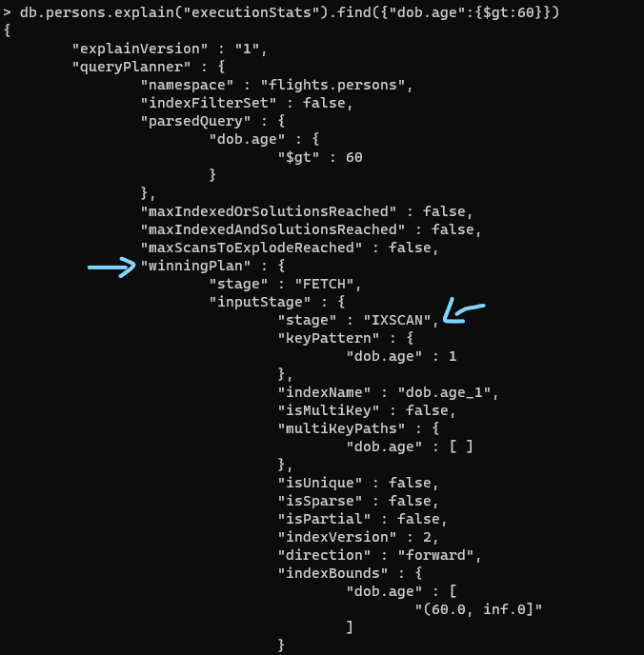
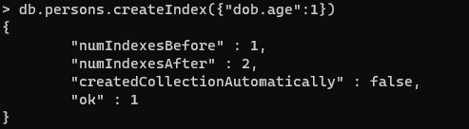
Add Index
Key: the name of the field
The value ascending or descending order 1 → ascending -1 → descending order.

